Slide 1
How Computers Work

Slide 2
take-aways
CIRCUITS / SWITCHES
CODING SCHEMES
BINARY DIGITS
2^{n}
5 generations of computers
Moore's Law
Bits
Bits, Bytes, KB, MB, GB, TB
Machine Language

Slide 3
How computers work
computers run on electricity

Slide 4
How computers work
computers run on electricity
electricity can be ON or OFF

Slide 5
How computers work
computers run on electricity
electricity can be ON or OFF
coding schemes

Slide 6
How computers work
computers run on electricity
electricity can be ON or OFF
coding schemes
assign meaning to ON or OFF state

Slide 7
How computers work
computers run on electricity
electricity can be ON or OFF
coding schemes
assign meaning to ON or OFF state
porch light on Halloween

Slide 8
How computers work
computers run on electricity
electricity can be ON or OFF
coding schemes
assign meaning to ON or OFF state
porch light on Halloween
1 porch light = 2 messages

Slide 9
How computers work
computers run on electricity
electricity can be ON or OFF
coding schemes
assign meaning to ON or OFF state
porch light on Halloween
1 porch light = 2 messages
2 porch lights = 4 messages

Slide 10
How computers work
computers run on electricity
electricity can be ON or OFF
coding schemes
assign meaning to ON or OFF state
porch light on Halloween
1 porch light = 2 messages
2 porch lights = 4 messages
3 porch lights = 8 messages

Slide 11
How computers work
computers run on electricity
electricity can be ON or OFF
coding schemes
assign meaning to ON or OFF state
porch light on Halloween
1 porch light = 2 messages
2 porch lights = 4 messages
3 porch lights = 8 messages
2
n

Slide 12
How computers work
computers run on electricity
electricity can be ON or OFF
coding schemes
assign meaning to ON or OFF state
porch light on Halloween
1 porch light = 2 messages
2 porch lights = 4 messages
3 porch lights = 8 messages
4 porch lights = __ messages
5 porch lights = __ messages
6 porch lights = __ messages
7 porch lights = __ messages
8 porch lights = __ messages
2
n

Slide 13
How computers work
computers run on electricity
electricity can be ON or OFF
coding schemes
assign meaning to ON or OFF state
porch light on Halloween
1 porch light = 2 messages
2 porch lights = 4 messages
3 porch lights = 8 messages
4 porch lights = 16 messages
5 porch lights = 32 messages
6 porch lights = 64 messages
7 porch lights = 128 messages
8 porch lights = 256 messages
2
n

Slide 14
How computers work
Coding schemes
computers run on electricity
electricity can be ON or OFF
coding schemes
assign meaning to ON or OFF state
porch light on Halloween
1 porch light = 2 messages
2 porch lights = 4 messages
3 porch lights = 8 messages
4 porch lights = 16 messages
5 porch lights = 32 messages
6 porch lights = 64 messages
7 porch lights = 128 messages
8 porch lights = 256 messages
on on | let’s party
on off | movie night
off on | study night
off off | sleeping

Slide 15
Todd’s Coding Scheme
0 0 0 | A
0 0 1 | B
0 1 0 | C
1 0 0 | D
1 1 0 | E
1 0 1 | F
0 1 1 | G
1 1 1 | H

Slide 16
Todd’s Coding Scheme
0 0 0 | A
0 0 1 | B
0 1 0 | C
1 0 0 | D
1 1 0 | E
1 0 1 | F
0 1 1 | G
1 1 1 | H
0 0 1
0 0 0
1 0 0
0 1 0
0 0 0
0 0 1

Slide 17
Todd’s Coding Scheme
0 0 0 | A
0 0 1 | B
0 1 0 | C
1 0 0 | D
1 1 0 | E
1 0 1 | F
0 1 1 | G
1 1 1 | H
0 0 1 | B
0 0 0
1 0 0
0 1 0
0 0 0
0 0 1

Slide 18
Todd’s Coding Scheme
0 0 0 | A
0 0 1 | B
0 1 0 | C
1 0 0 | D
1 1 0 | E
1 0 1 | F
0 1 1 | G
1 1 1 | H
0 0 1 | B
0 0 0 | A
1 0 0
0 1 0
0 0 0
0 0 1

Slide 19
Todd’s Coding Scheme
0 0 0 | A
0 0 1 | B
0 1 0 | C
1 0 0 | D
1 1 0 | E
1 0 1 | F
0 1 1 | G
1 1 1 | H
0 0 1 | B
0 0 0 | A
1 0 0 | D
0 1 0
0 0 0
0 0 1

Slide 20
Todd’s Coding Scheme
0 0 0 | A
0 0 1 | B
0 1 0 | C
1 0 0 | D
1 1 0 | E
1 0 1 | F
0 1 1 | G
1 1 1 | H
0 0 1 | B
0 0 0 | A
1 0 0 | D
0 1 0 | C
0 0 0
0 0 1

Slide 21
Todd’s Coding Scheme
0 0 0 | A
0 0 1 | B
0 1 0 | C
1 0 0 | D
1 1 0 | E
1 0 1 | F
0 1 1 | G
1 1 1 | H
0 0 1 | B
0 0 0 | A
1 0 0 | D
0 1 0 | C
0 0 0 | A
0 0 1

Slide 22
Todd’s Coding Scheme
0 0 0 | A
0 0 1 | B
0 1 0 | C
1 0 0 | D
1 1 0 | E
1 0 1 | F
0 1 1 | G
1 1 1 | H
0 0 1 | B
0 0 0 | A
1 0 0 | D
0 1 0 | C
0 0 0 | A
0 0 1 | B

Slide 23
How computers work
Coding schemes
computers run on electricity
electricity can be ON or OFF
coding schemes
assign meaning to ON or OFF state
porch light on Halloween
1 porch light = 2 messages
2 porch lights = 4 messages
3 porch lights = 8 messages
4 porch lights = 16 messages
5 porch lights = 32 messages
6 porch lights = 64 messages
7 porch lights = 128 messages
8 porch lights = 256 messages
on on | let’s party
on off | movie night
off on | study night
off off | sleeping

Slide 24
How computers work
Coding schemes
computers run on electricity
electricity can be ON or OFF
coding schemes
assign meaning to ON or OFF state
porch light on Halloween
1 porch light = 2 messages
2 porch lights = 4 messages
3 porch lights = 8 messages
4 porch lights = 16 messages
5 porch lights = 32 messages
6 porch lights = 64 messages
7 porch lights = 128 messages
8 porch lights = 256 messages
on on (1 1) | let’s party
on off (1 0) | movie night
off on (0 1) | study night
off off (0 0) | sleeping

Slide 25

How computers work
Coding schemes
computers run on electricity
electricity can be ON or OFF
coding schemes
assign meaning to ON or OFF state
porch light on Halloween
1 porch light = 2 messages
2 porch lights = 4 messages
3 porch lights = 8 messages
4 porch lights = 16 messages
5 porch lights = 32 messages
6 porch lights = 64 messages
7 porch lights = 128 messages
8 porch lights = 256 messages
on on (1 1) | let’s party
on off (1 0) | movie night
off on (0 1) | study night
off off (0 0) | sleeping

Slide 26
How computers work
Coding schemes
computers run on electricity
electricity can be ON or OFF
coding schemes
assign meaning to ON or OFF state
porch light on Halloween
1 porch light = 2 messages
2 porch lights = 4 messages
3 porch lights = 8 messages
4 porch lights = 16 messages
5 porch lights = 32 messages
6 porch lights = 64 messages
7 porch lights = 128 messages
8 porch lights = 256 messages
1 1 | let’s party
1 0 | movie night
0 1 | study night
0 0 | sleeping

Slide 27
How computers work
Coding schemes
computers run on electricity
electricity can be ON or OFF
coding schemes
assign meaning to ON or OFF state
porch light on Halloween
1 porch light = 2 messages
2 porch lights = 4 messages
3 porch lights = 8 messages
4 porch lights = 16 messages
5 porch lights = 32 messages
6 porch lights = 64 messages
7 porch lights = 128 messages
8 porch lights = 256 messages
1 1 | let’s party
1 0 | movie night
0 1 | study night
0 0 | sleeping
Binary Digits

Slide 28
How computers work
Coding schemes
computers run on electricity
electricity can be ON or OFF
coding schemes
assign meaning to ON or OFF state
porch light on Halloween
1 porch light = 2 messages
2 porch lights = 4 messages
3 porch lights = 8 messages
4 porch lights = 16 messages
5 porch lights = 32 messages
6 porch lights = 64 messages
7 porch lights = 128 messages
8 porch lights = 256 messages
1 1 | let’s party
1 0 | movie night
0 1 | study night
0 0 | sleeping
Binary Digits

Slide 29
How computers work
Coding schemes
computers run on electricity
electricity can be ON or OFF
coding schemes
assign meaning to ON or OFF state
porch light on Halloween
1 porch light = 2 messages
2 porch lights = 4 messages
3 porch lights = 8 messages
4 porch lights = 16 messages
5 porch lights = 32 messages
6 porch lights = 64 messages
7 porch lights = 128 messages
8 porch lights = 256 messages
1 1 | let’s party
1 0 | movie night
0 1 | study night
0 0 | sleeping
Binary Digits
Bits

Slide 30
How computers work
Coding schemes
computers run on electricity
electricity can be ON or OFF
coding schemes
assign meaning to ON or OFF state
porch light on Halloween
1 porch light = 2 messages
2 porch lights = 4 messages
3 porch lights = 8 messages
4 porch lights = 16 messages
5 porch lights = 32 messages
6 porch lights = 64 messages
7 porch lights = 128 messages
8 porch lights = 256 messages
1 1 | a
1 0 | b
0 1 | c
0 0 | d
Binary Digits
Bits

Slide 31
ON & OFF, 1 & 0, Binary Digits, Bits, and Machine Language are all words used to refer to this idea that, within a computer, it's all nothing but a bunch of ZERO's and ONE's, or switches that are ON or OFF, it's all just a bunch of Binary Digits, or Bits, that's the language which computers speak, it's machine language.

Slide 32
circuits, switches, transistors, and even "gates" are all words used to refer to this thing within a computer that can either be ON or OFF. It's a circuit, it's a switch, it's a gate that can either be OPENED or CLOSED, it's a transistor - you will learn that people use all of those words to talk about this same thing, this ability of computers to store ON / OFF states.

Slide 33
ascii

Slide 34
UTF-8

Slide 35
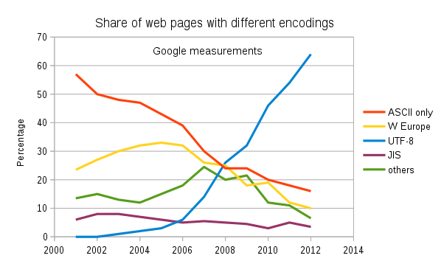
UTF-8

Slide 36
Measuring Bits
1 bit
8 bits = byte
1000 bytes = kb
1000 kb = mb
1000 mb = gb
1000 gb = tb

Slide 37
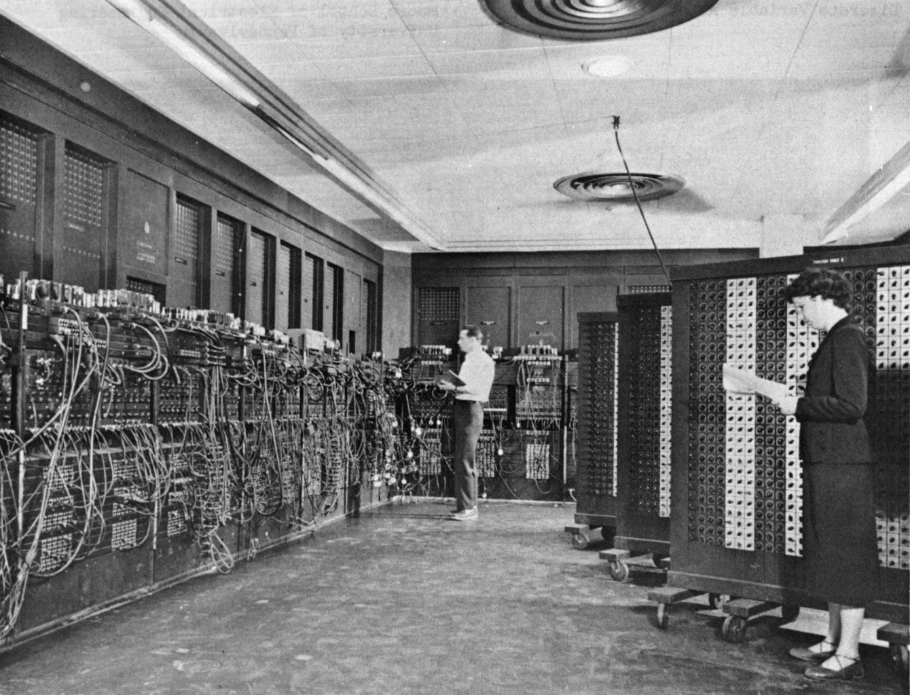
16,000 circuits
(vacuum tubes)

Slide 38
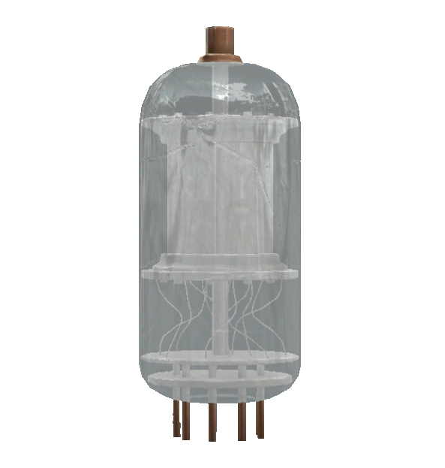
16,000 circuits
(vacuum tubes)

Slide 39
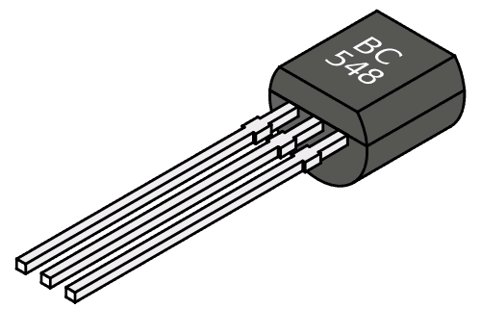
16,000 circuits
(vacuum tubes)

Slide 40
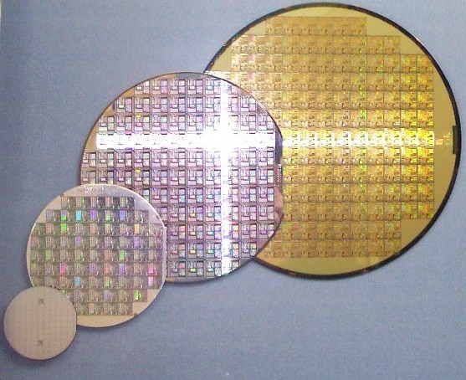
16,000 circuits
(vacuum tubes)

Slide 41
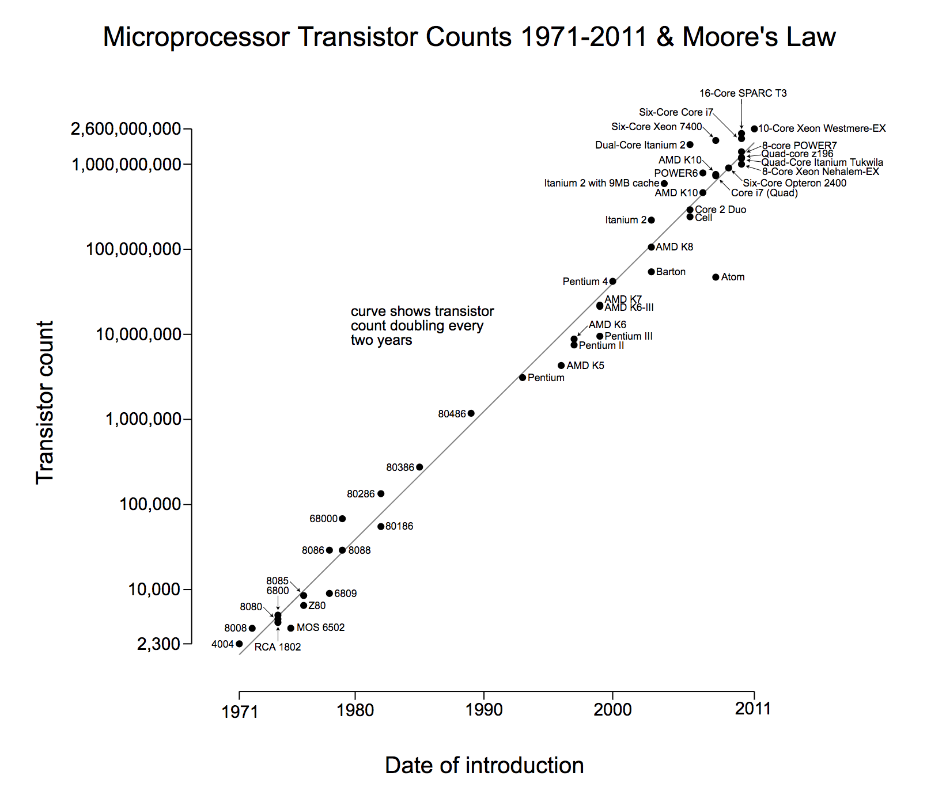
16,000 circuits
(vacuum tubes)

Slide 42
16,000 circuits
(vacuum tubes)
Moore’s Law

Slide 43
Generations of Computers
Vacuum tubes
Transistors
Integrated circuits (chips)
Microprocessors (cpu’s)
Notes:
*
*

Slide 44
numeral systems

Slide 45
word

